Slide 1

Presentation on MongoTemplate
Prepared By : Mayank Jain

Slide 2
Content
Mongo DB Introduction
Mongo DB Vs MySql
Ways To Implement With Spring
Setup & Configuration
Example
Mongo DB GUI Tools

Slide 3

Mongo DB Introduction
Document-oriented NoSQL database.
Used for high volume data storage.
It is an open-source, cross-platform database.

Slide 4

Mongo DB VS MySql

Slide 5
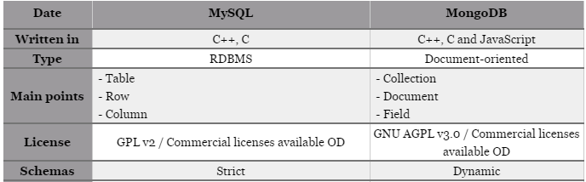
Mongo DB VS MySql

Slide 6
Ways To Implement With Spring
Mongo Template :
provides out-of-the-box methods which allow you to modify a document in a single operation.
The Update object used by these methods also allows you to target only the relevant fields.
Notes:
provides out-of-the-box updateFirst, updateMulti, findAndModify, upsert... methods which allow you to modify a document in a single operation. The Update object used by these methods also allows you to target only the relevant fields.

Slide 7
Ways To Implement With Spring
Mongo Repository
only gives you the basic find, insert, save, delete operations .
This forces you to either update the documents in several steps or define your own update queries by hand using @Query
Notes:
only gives you the basic find, insert, save, delete operations, which work with POJOs containing all the fields. This forces you to either update the documents in several steps (find the document to update, modify the relevant fields from the returned POJO, and then save it), or define your own update queries by hand using @Query

Slide 8
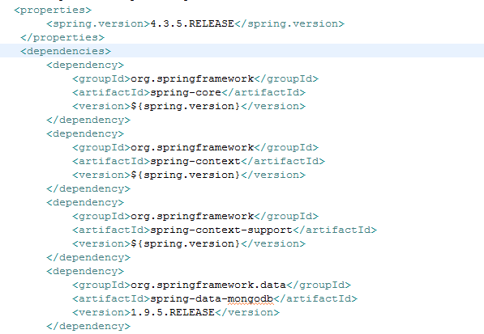
Setup & Configuration
Add following dependency in pom.xml

Slide 9
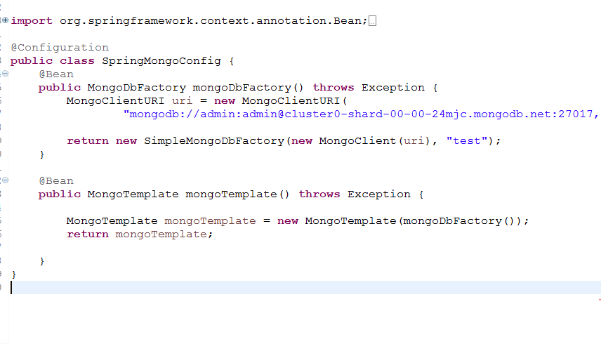
Setup & Configuration
Download and install mongoDB server.
Configure mongo with spring by either annotation based configuration or xml based.

Slide 10
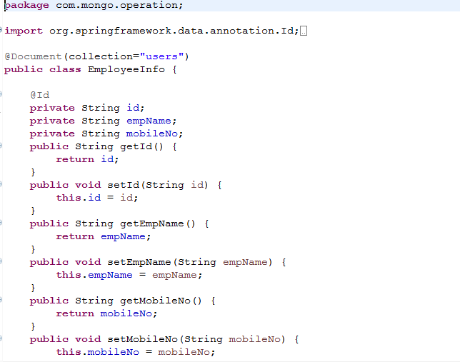
Example
Mongo Template.

Slide 11
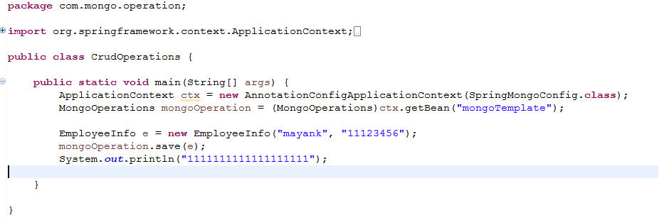
Example
Save Operation.

Slide 12
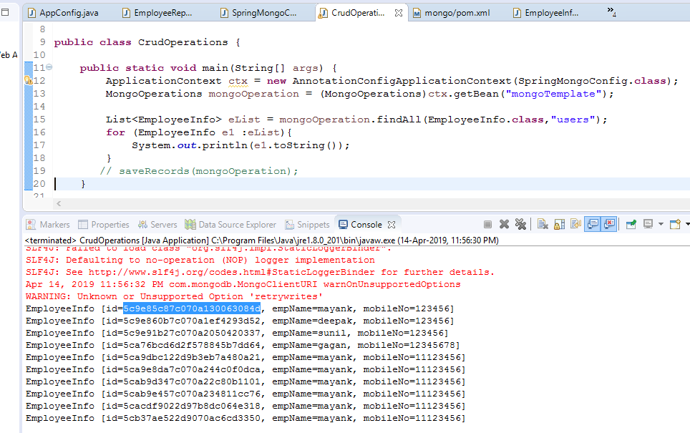
Example
Get All Operation.

Slide 13
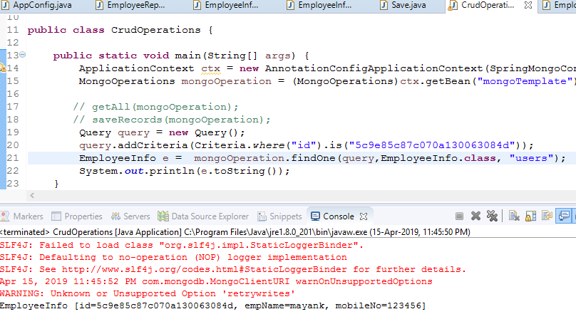
Example
Find One Operation.

Slide 14
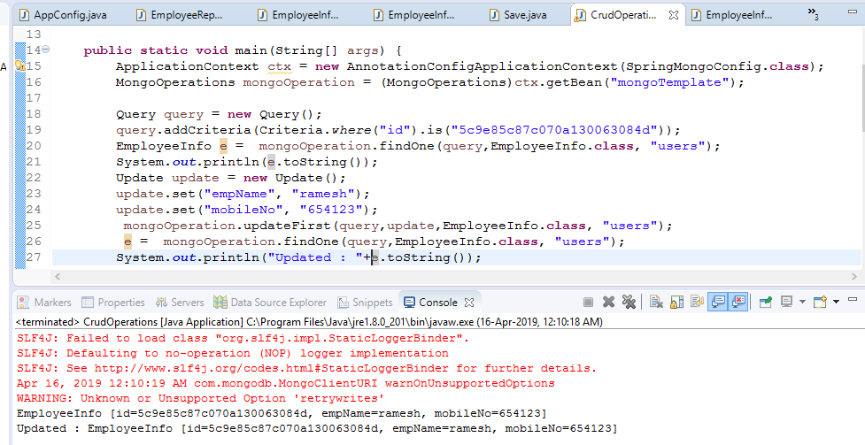
Example
Update Operation.

Slide 15
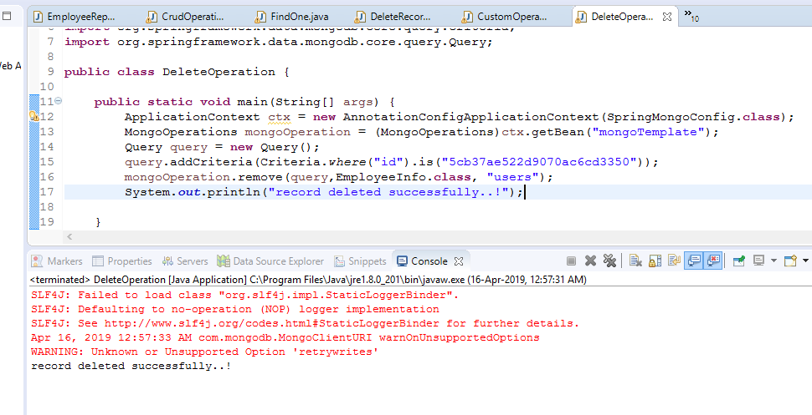
Example
Delete Operation.

Slide 16
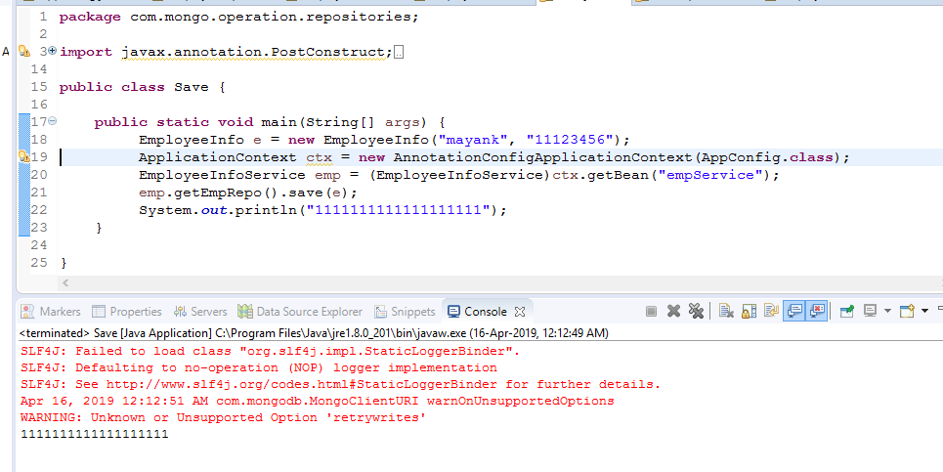
Mongo Repositories Example
Save Operation.
Notes:
only gives you the basic find, insert, save, delete operations, which work with POJOs containing all the fields. This forces you to either update the documents in several steps (find the document to update, modify the relevant fields from the returned POJO, and then save it), or define your own update queries by hand using @Query

Slide 17
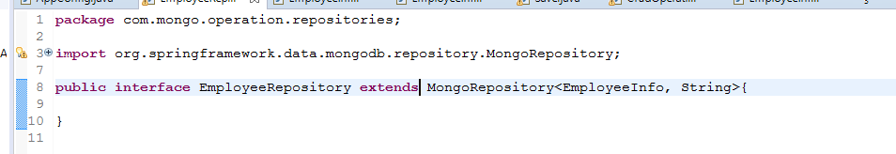
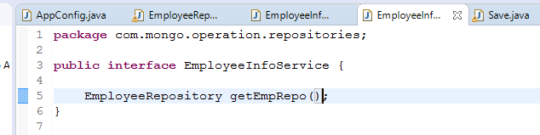
Mongo Repositories Example
Save Operation.
Notes:
only gives you the basic find, insert, save, delete operations, which work with POJOs containing all the fields. This forces you to either update the documents in several steps (find the document to update, modify the relevant fields from the returned POJO, and then save it), or define your own update queries by hand using @Query

Slide 18
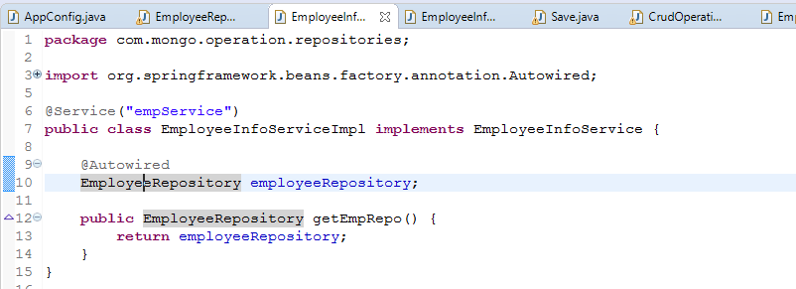
Mongo Repositories Example
Save Operation.
Notes:
only gives you the basic find, insert, save, delete operations, which work with POJOs containing all the fields. This forces you to either update the documents in several steps (find the document to update, modify the relevant fields from the returned POJO, and then save it), or define your own update queries by hand using @Query

Slide 19
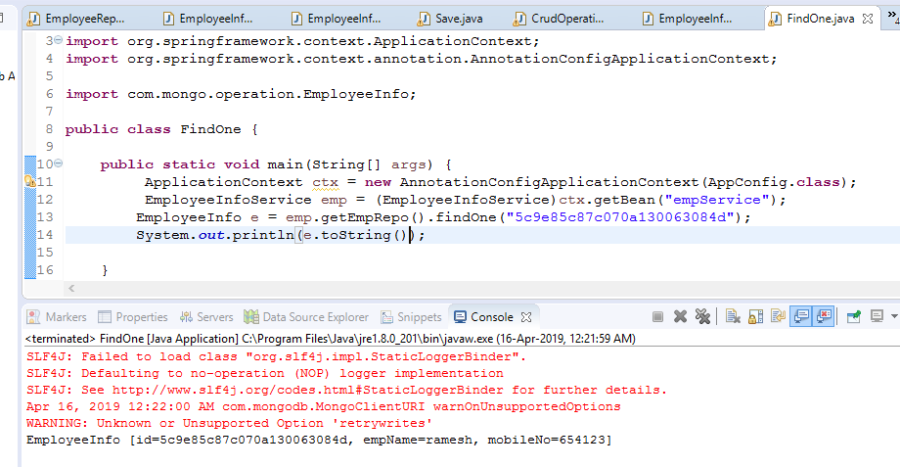
Mongo Repositories Example
Find One Operation.
Notes:
only gives you the basic find, insert, save, delete operations, which work with POJOs containing all the fields. This forces you to either update the documents in several steps (find the document to update, modify the relevant fields from the returned POJO, and then save it), or define your own update queries by hand using @Query

Slide 20
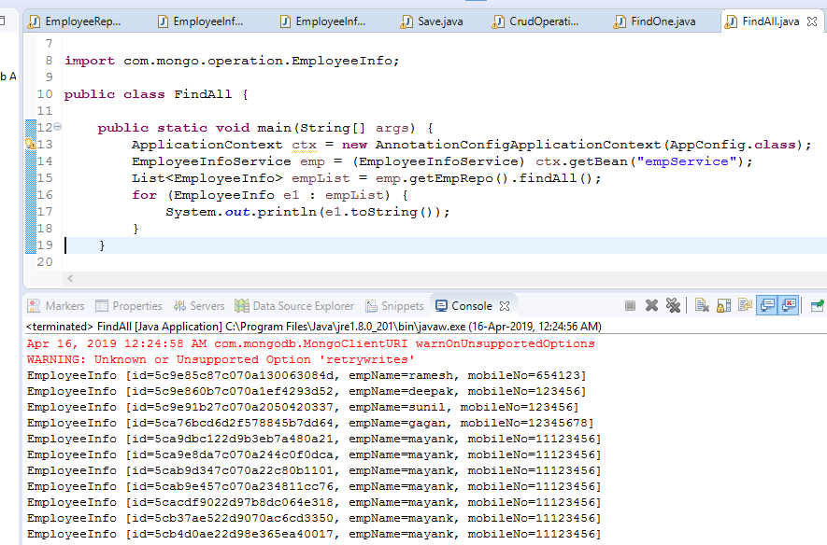
Mongo Repositories Example
Find All Operation.
Notes:
only gives you the basic find, insert, save, delete operations, which work with POJOs containing all the fields. This forces you to either update the documents in several steps (find the document to update, modify the relevant fields from the returned POJO, and then save it), or define your own update queries by hand using @Query

Slide 21
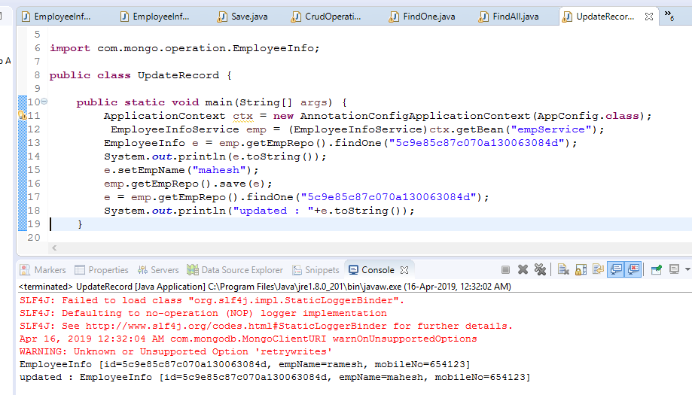
Mongo Repositories Example
Update Operation.
Notes:
only gives you the basic find, insert, save, delete operations, which work with POJOs containing all the fields. This forces you to either update the documents in several steps (find the document to update, modify the relevant fields from the returned POJO, and then save it), or define your own update queries by hand using @Query

Slide 22
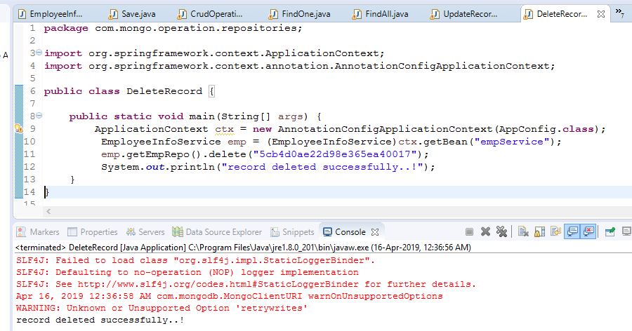
Mongo Repositories Example
Delete Operation.
Notes:
only gives you the basic find, insert, save, delete operations, which work with POJOs containing all the fields. This forces you to either update the documents in several steps (find the document to update, modify the relevant fields from the returned POJO, and then save it), or define your own update queries by hand using @Query

Slide 23
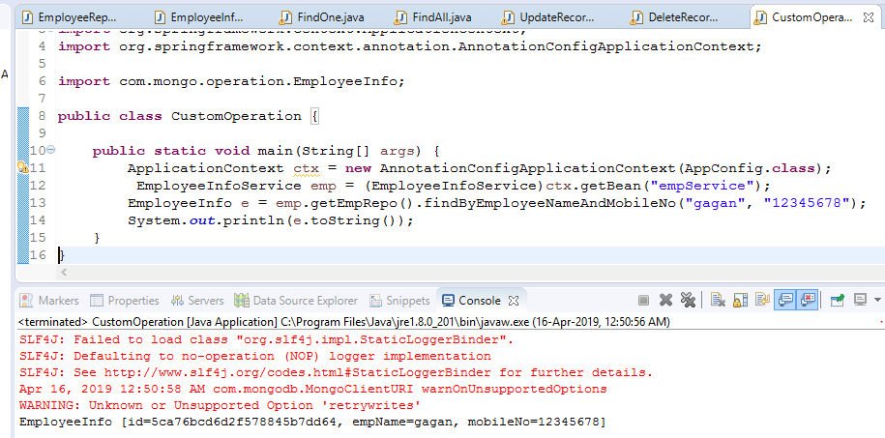
Mongo Repositories Example
Custom Operation.
Notes:
only gives you the basic find, insert, save, delete operations, which work with POJOs containing all the fields. This forces you to either update the documents in several steps (find the document to update, modify the relevant fields from the returned POJO, and then save it), or define your own update queries by hand using @Query

Slide 24
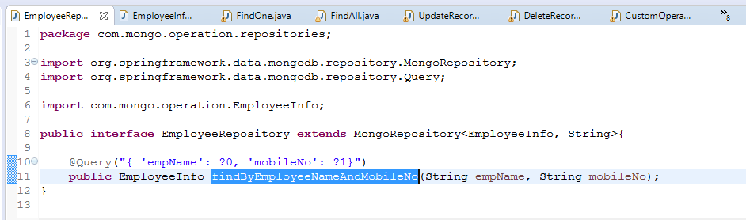
Mongo Repositories Example
Custom Operation.
Notes:
only gives you the basic find, insert, save, delete operations, which work with POJOs containing all the fields. This forces you to either update the documents in several steps (find the document to update, modify the relevant fields from the returned POJO, and then save it), or define your own update queries by hand using @Query

Slide 25





Mongo DB GUI Tools

Slide 26
Thanks....

